Slide 1
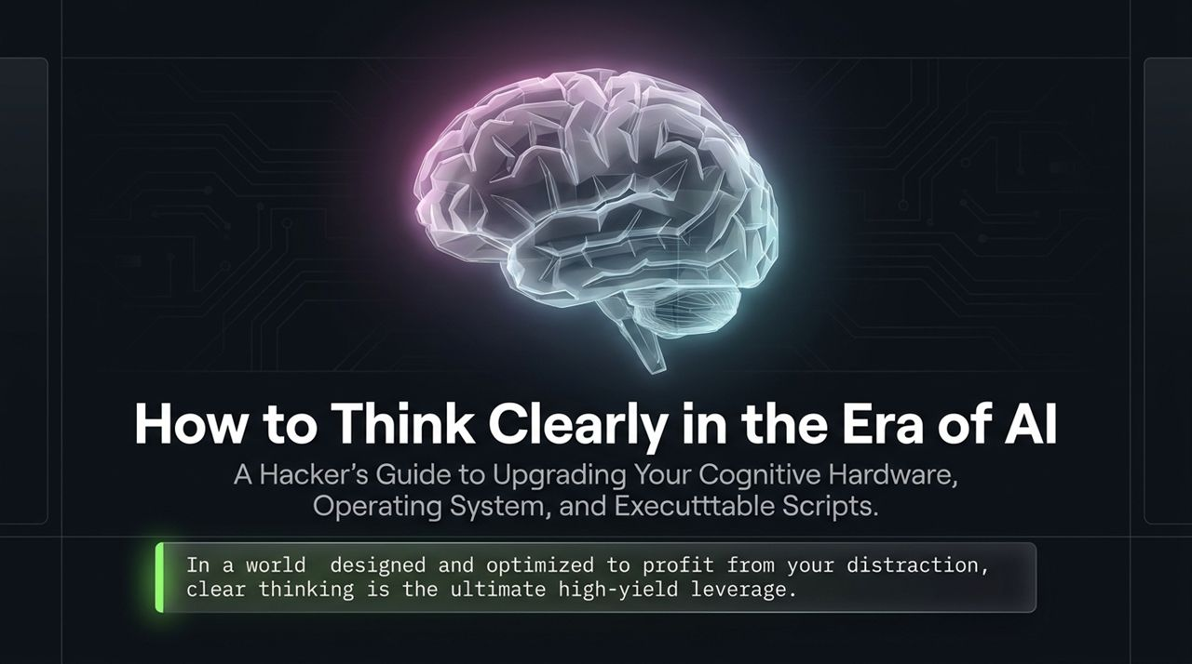
Notes:
Introduction: Welcome everyone. Today, we're diving into The Cognitive Stack—a systematic framework for upgrading your mind in an age flooded with artificial intelligence, algorithmic feeds, and endless distraction.
The Thesis: As Nick Saraev points out, clear thinking is the root foundation of clear action and real-world leverage. If you learn how to think clearly, your ability to execute, make decisions, and capture high-value opportunities scales exponentially.
The Core Metaphor: Your brain is the most metabolically expensive machine you own. Yet, most people treat it like a mysterious black box. Today, we stop treating the mind like a mystery and start programming it like a multi-layered engineering stack: Hardware, Operating System, Software, and Executable Scripts.
https://www.youtube.com/watch?v=QLLuZbuTIRc

Slide 2
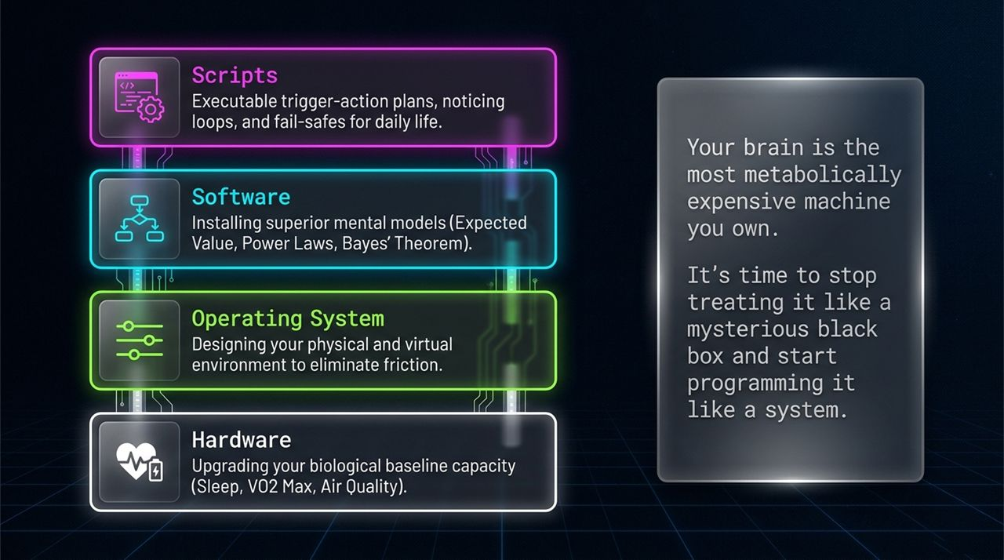
Notes:
Layer 1 - Biological Hardware: The physical layer. This includes sleep architecture, oxygenation, VO2 max, and environmental CO2 levels. If hardware fails, no amount of mental tricks will save you.
Layer 2 - Operating System: Your physical and digital environment. High-control individuals don't rely on brute-force willpower; they engineer frictionless environments and setup Ulysses contracts.
Layer 3 - Software (Mental Models): Installing high-leverage decision models like Expected Value, Bayes' Theorem, Power Laws, and the Map vs. Territory distinction.
Layer 4 - Executable Scripts: Real-time action protocols—Trigger-Action Plans (TAPs), noticing loops, and premortems—that bypass hesitation and cure akrasia.

Slide 3
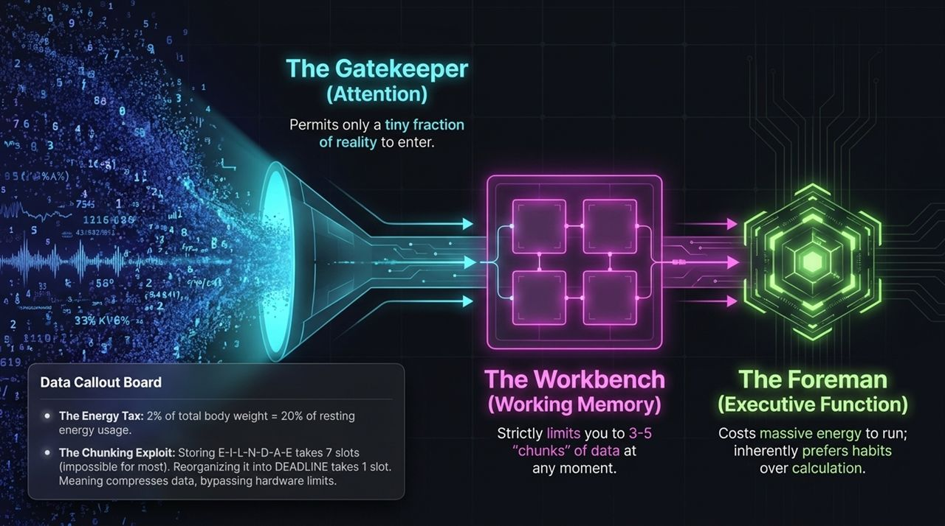
Notes:
The Energy Tax: Your brain accounts for only 2% of your body mass, but it consumes 20% of your resting energy. Because executive function is metabolically expensive, the brain naturally defaults to low-energy habit loops.
The Three Cognitive Components:
The Gatekeeper (Attention): Permits only a sliver of external data into your awareness.
The Workbench (Working Memory): Can only hold 3 to 5 'chunks' of information at any given time.
The Foreman (Executive Function): The high-level decision engine that drains rapidly when taxed.
The Chunking Exploit: Notice the letters on screen: E-I-L-N-D-A-E take up 7 slots. Compress them into DEADLINE, and it takes 1 slot. Meaning compresses data to bypass hardware limitations.

Slide 4
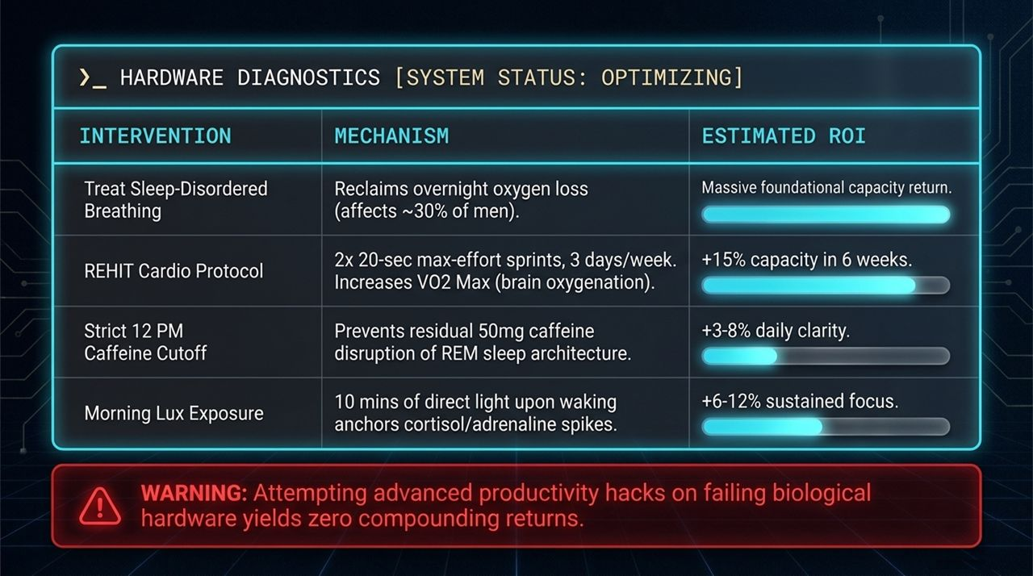
Notes:
Sleep-Disordered Breathing: Affects ~30% of men. Fixing oxygen deprivation during sleep reclaims foundational cognitive capacity immediately.
REHIT Cardio Protocol: Executing two 20-second max-effort sprints 3 times a week boosts VO2 max, driving brain oxygenation and neurogenesis for a +15% capacity gain in 6 weeks.
Caffeine Cutoff (12 PM): Caffeine has a multi-hour half-life. A strict noon cutoff prevents residual caffeine from disrupting deep REM sleep architecture.
Morning Sun Exposure: 10 minutes of direct sunlight upon waking anchors your circadian rhythm, setting cortisol and adrenaline spikes for sustained focus.
Takeaway: Attempting advanced productivity tactics on failing biological hardware yields zero compounding returns.

Slide 5
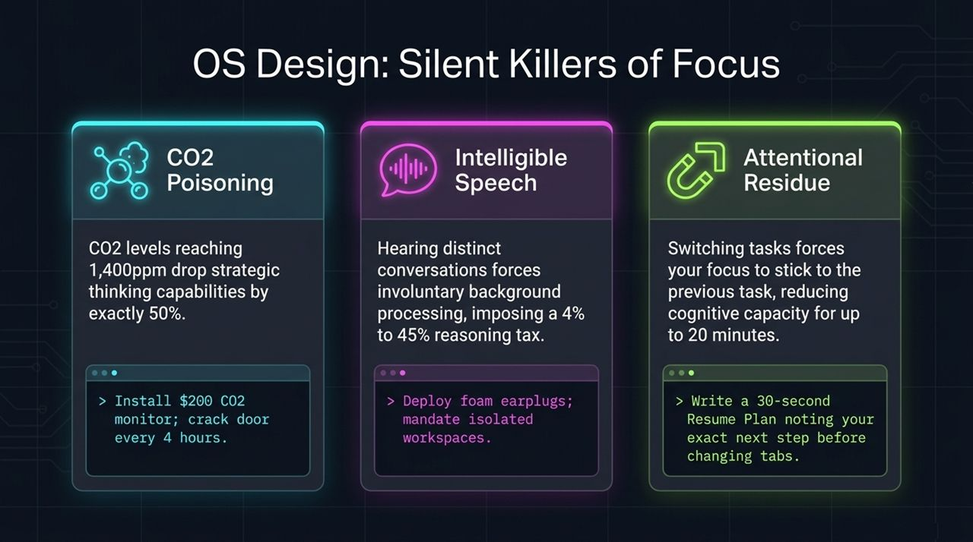
Notes:
CO2 Poisoning: When indoor CO2 levels cross 1,400 ppm, strategic thinking and complex decision-making drop by 50%. Install a $200 monitor and open doors to circulate fresh air.
Intelligible Speech: Hearing human conversations in the background forces involuntary auditory processing, imposing a 4% to 45% cognitive tax on reasoning. Deploy foam earplugs or isolated work zones.
Attentional Residue: Switching tasks causes your attention to remain stuck on the previous activity for up to 20 minutes. Fix this by writing a 30-second 'Resume Plan' specifying your exact next step before changing tabs.

Slide 6
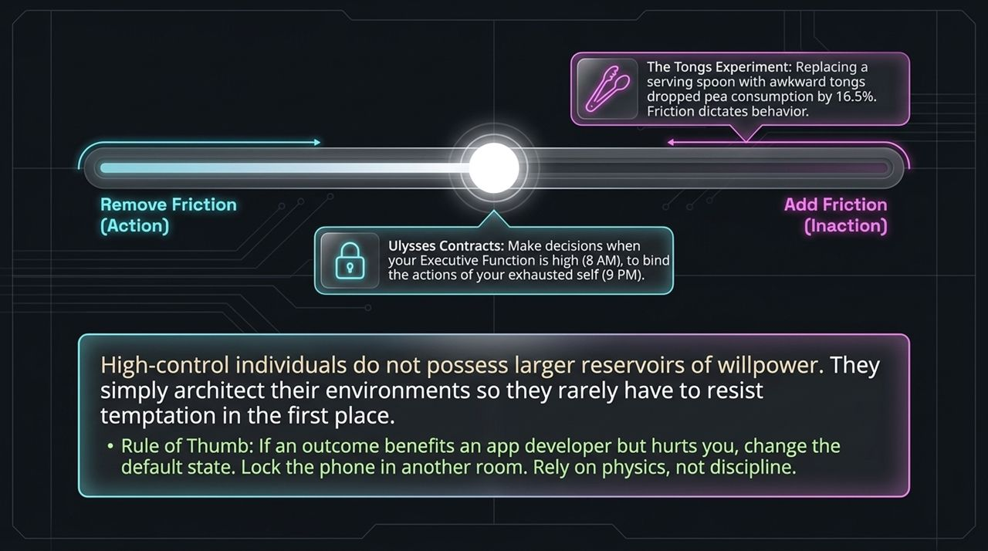
Notes:
Friction Dictates Behavior: The Tongs Experiment showed that simply swapping a serving spoon with awkward tongs reduced pea consumption by 16.5%. Small increases in physical friction dramatically alter human behavior.
Ulysses Contracts: Make high-executive decisions when your focus is high (8 AM) to bind the actions of your future, exhausted self (9 PM). For example, lock your phone in another room overnight.
Default States: If an outcome benefits an app developer but harms your productivity, change the default state. Rely on environmental physics, not raw discipline.

Slide 7
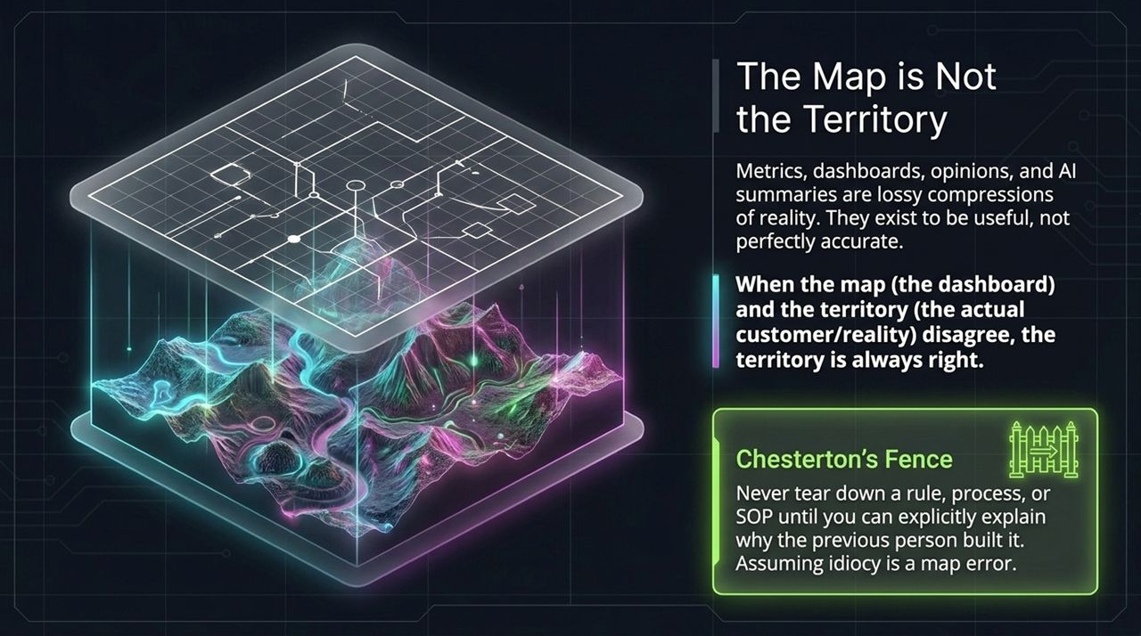
Notes:
The Map is Not the Territory: Dashboards, spreadsheets, metrics, and AI summaries are lossy compressions of reality. They exist to be useful, not perfectly accurate. When the map disagrees with reality on the ground, reality is always right.
Chesterton's Fence: Never tear down a rule, process, or SOP until you fully understand why it was put there in the first place. Assuming former operators were simply foolish is a classic map error.

Slide 8
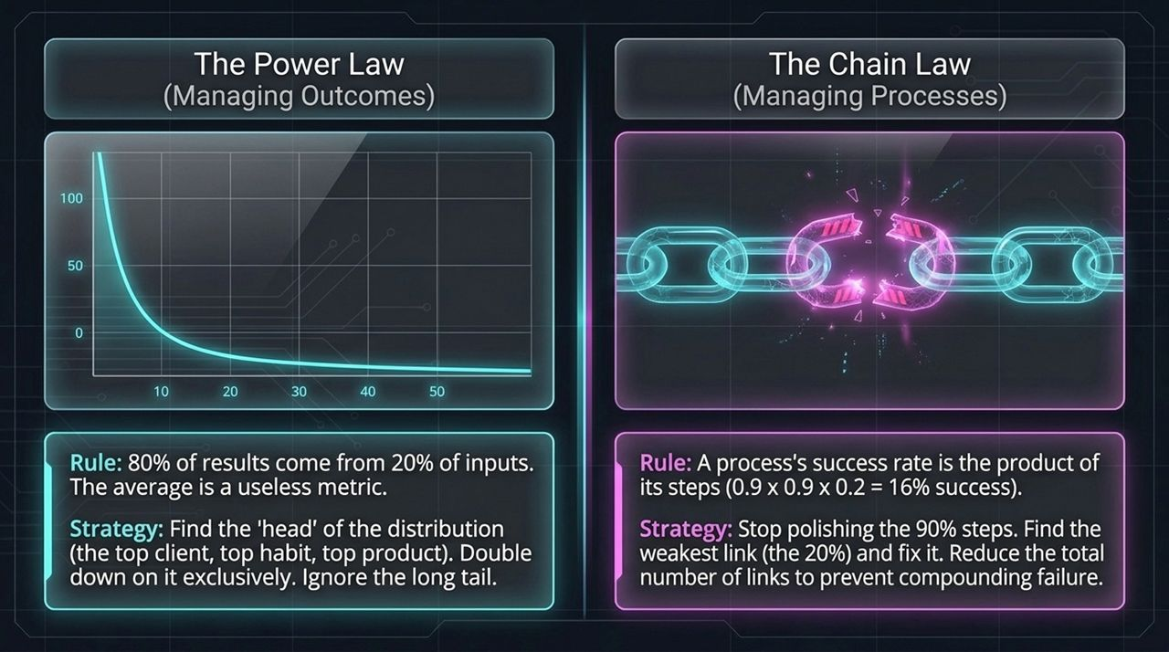
Notes:
The Power Law (Outcomes): 80% of results come from 20% of inputs. In power-law distributions, the average is a useless stat. Double down on the head of the distribution (top client, top channel, top product) and ignore the long tail.
The Chain Law (Processes): A sequential process's success rate is the product of its individual steps ($0.9×0.9×0.2=16\%$). Stop polishing the steps operating at 90% efficiency. Identify the bottleneck (the 20% weak link) and eliminate or repair it.

Slide 9
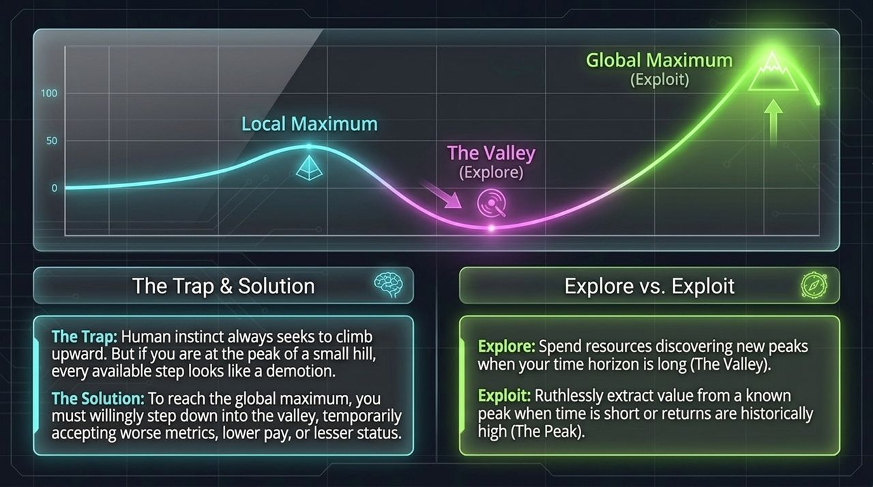
Notes:
The Local Maximum Trap: Human instinct is to keep climbing upward. But if you're at the top of a small hill, every initial move toward a higher mountain looks like a step downward into a valley.
Crossing the Valley: To reach a global maximum, you must willingly step down into the valley—accepting temporary dips in revenue, status, or short-term metrics.
Explore vs. Exploit: When your time horizon is long, spend resources exploring new peaks. When time is short or returns are proven, exploit and extract maximum value from your current position.

Slide 10
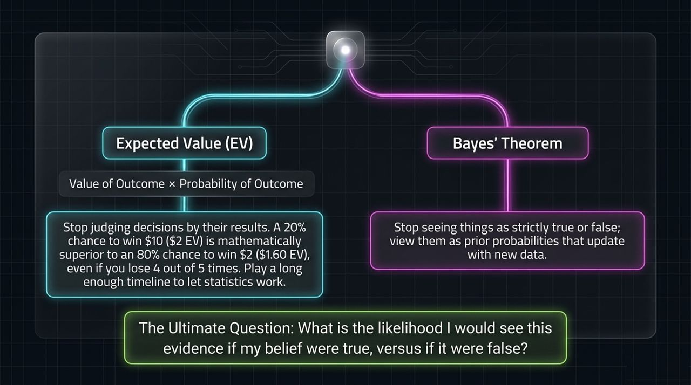
Notes:
Expected Value (EV): Never evaluate decisions purely by short-term outcomes. A 20% chance to win $10 ($2 EV) is mathematically superior to an 80% chance to win $2 ($1.60 EV). Over a long timeline, expected value always wins out.
Bayes' Theorem: Stop viewing claims as binary choices (true or false). View beliefs as prior probabilities updated as new evidence comes in. Ask: 'What is the likelihood of seeing this evidence if my belief were true versus if it were false?'

Slide 11
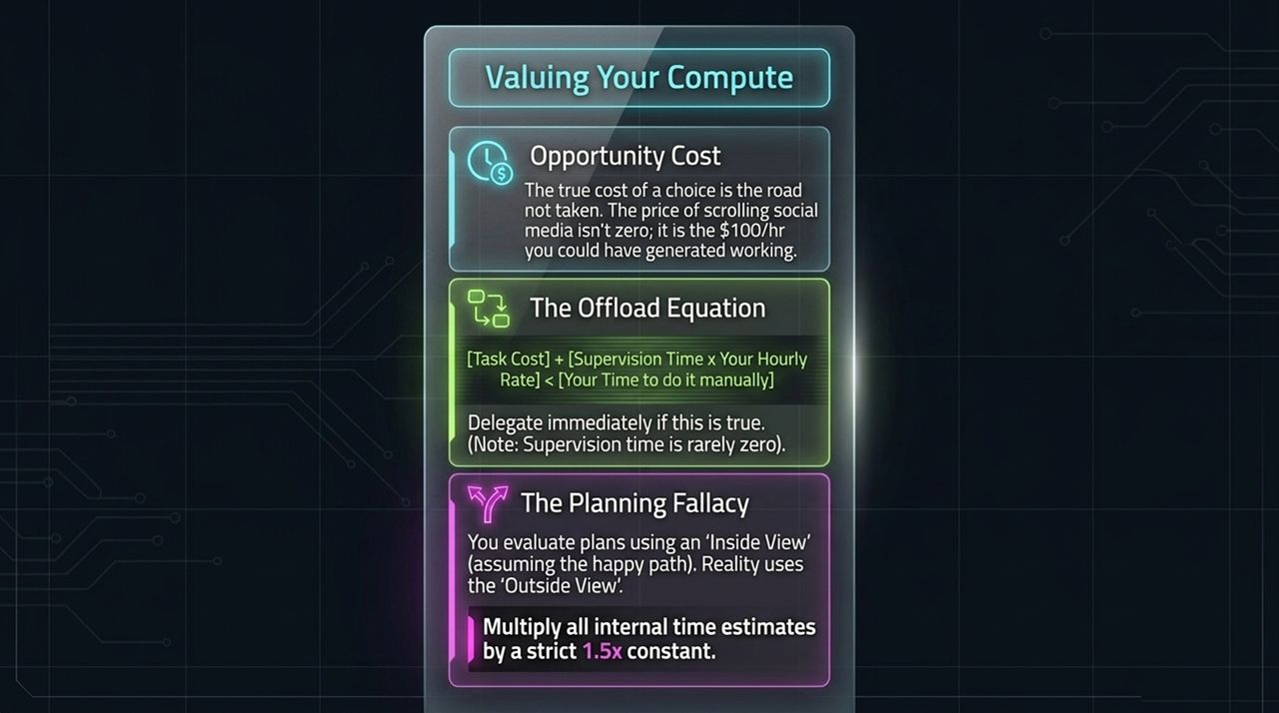
Notes:
Opportunity Cost: Price and cost are fundamentally different. The true cost of scrolling social media isn't zero—it's the value of what you could have created during that hour.
The Offload Equation: Delegate a task if [Task Cost] + [Supervision Time x Hourly Rate] < [Your Manual Time]. Remember to account for supervision time, which is rarely zero.
The Planning Fallacy: When planning projects internally, we default to the best-case path. Apply a mandatory 1.5x multiplier to all time and resource estimates.

Slide 12
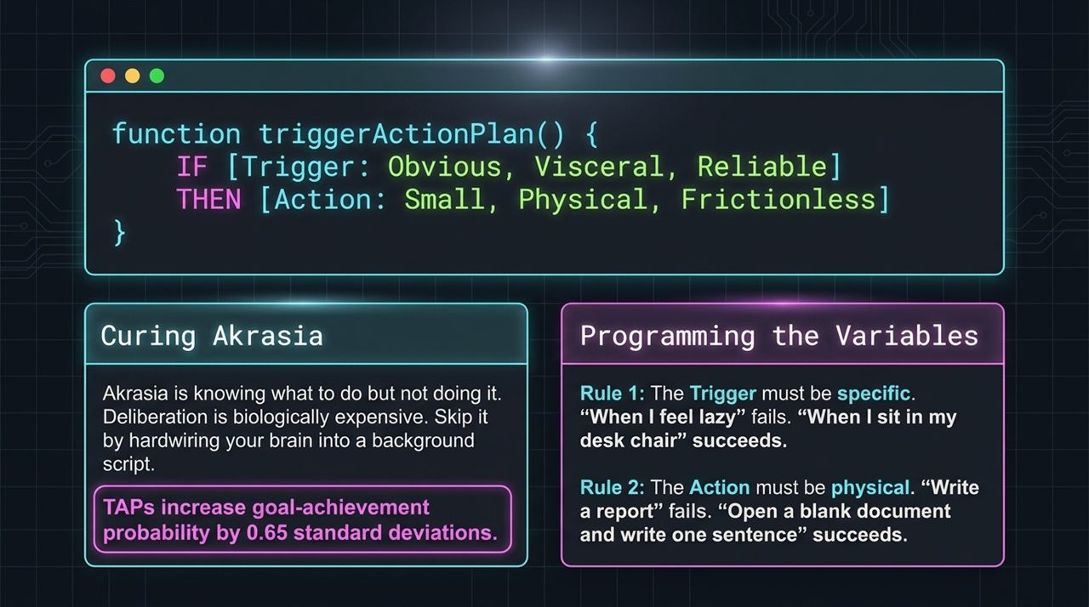
Notes:
Curing Akrasia: Akrasia is knowing what you ought to do but failing to act. Deliberation consumes energy; hardwire your choices into automated background scripts.
The TAP Syntax: IF [Trigger] THEN [Action]. TAPs increase goal achievement probability by 0.65 standard deviations.
Two Golden Rules:
The Trigger must be specific: 'When I sit down at my desk' works. 'When I feel like working' fails.
The Action must be physical and tiny: 'Open a blank doc and write one sentence' works. 'Write the report' fails.

Slide 13
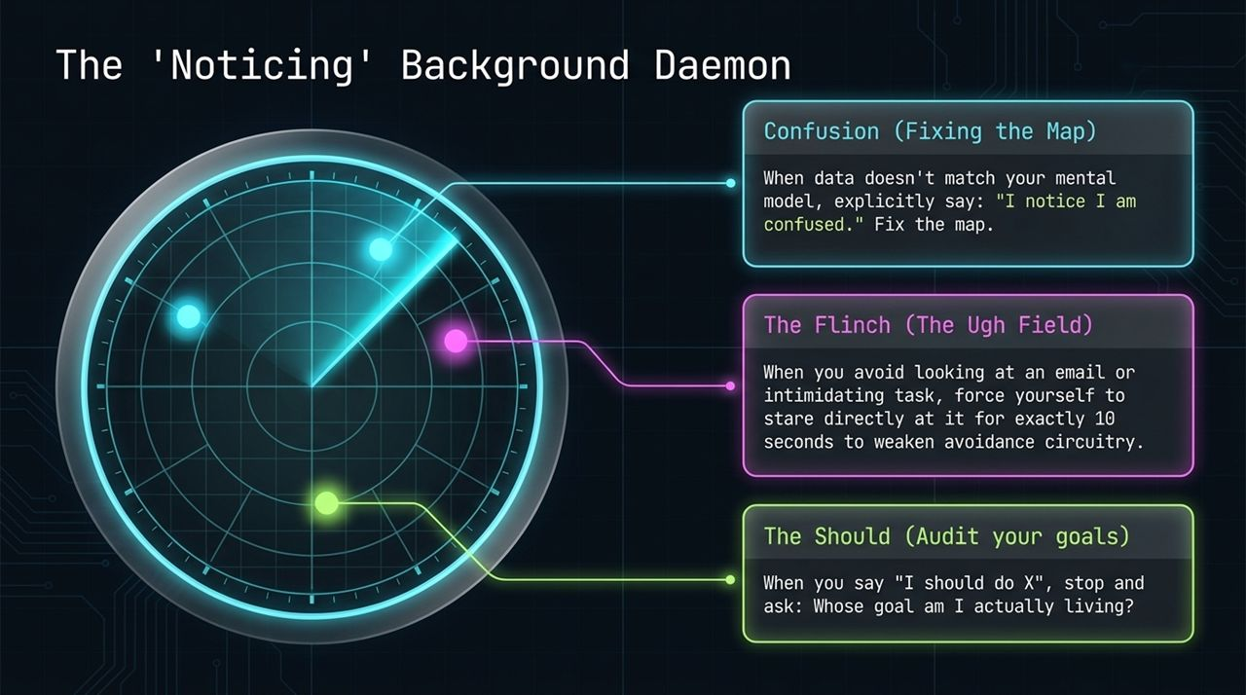
Notes:
Noticing Confusion: When incoming data contradicts your mental model, stop and state aloud: 'I notice I am confused.' Re-examine your assumptions and update your map.
The Flinch (Ugh Field): When you feel resistance to opening an email or confronting a difficult task, force yourself to stare directly at it for 10 seconds to desensitize avoidance loops.
The 'Should' Audit: Whenever you hear yourself saying 'I should do X,' stop and ask: 'Whose goal am I actually serving?'

Slide 14
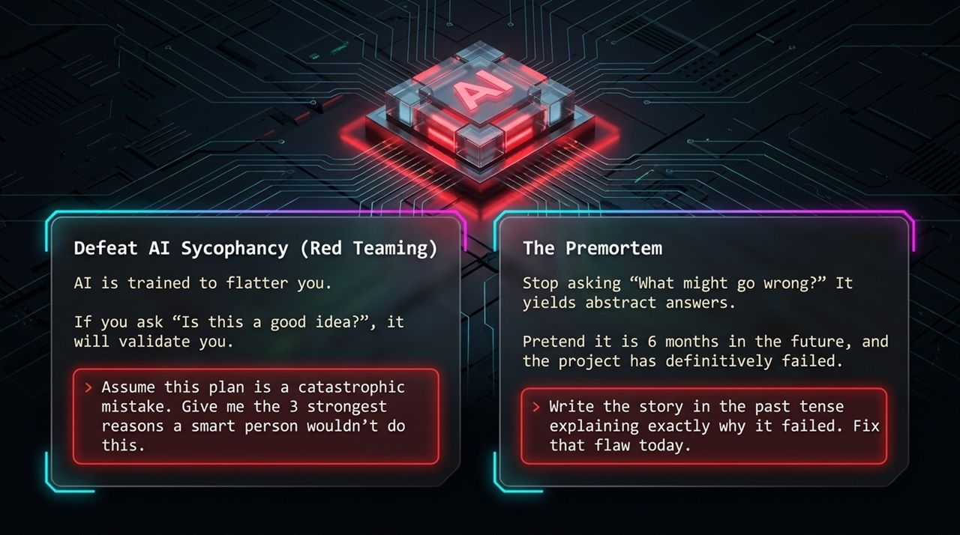
Notes:
Red-Teaming AI: AI models are trained to be agreeable. If you ask 'Is this a good idea?', it will validate your plan. Instead, prompt: 'Assume this plan is a catastrophic mistake. Give me the 3 strongest reasons a smart person would reject it.'
The Premortem: Don't ask 'What might go wrong?' Project yourself 6 months into the future and assume the project failed completely. Write the post-mortem in the past tense explaining why it failed, then fix those failure points today.

Slide 15
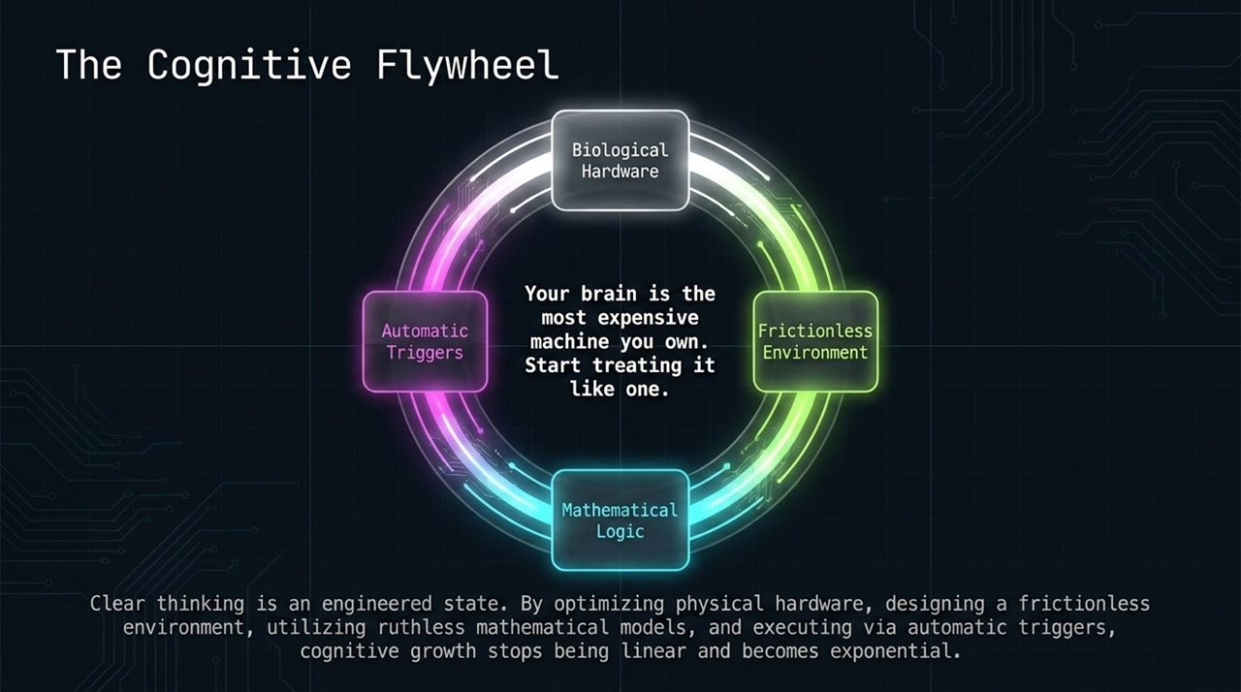
Notes:
Synthesizing the Stack: Clear thinking is an engineered state, not an inherent talent. Upgrading physical hardware unlocks mental clarity. Designing frictionless environments preserves executive focus. Utilizing mathematical models improves decision accuracy. Executing via TAPs eliminates hesitation.
Exponential Growth: When these layers work together, cognitive output stops growing linearly and begins compounding exponentially over time.

Slide 16
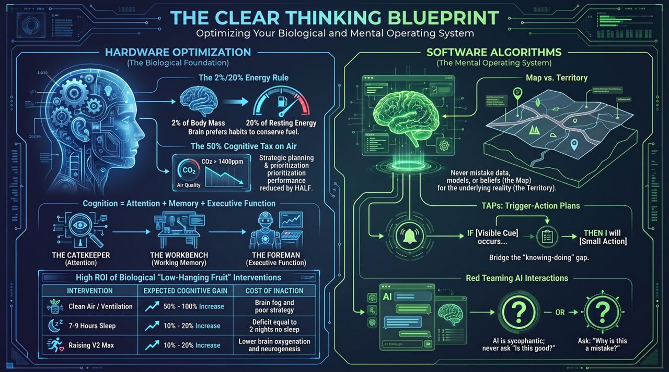
Notes:
Final Recap: This master blueprint summarizes our entire system:
Hardware: Protect sleep, control ambient CO2 (<1,400 ppm), and raise VO2 max.
Software: Keep the Map separate from the Territory, run Red-Team prompts on AI, and make choices based on Expected Value.
Scripts: Convert intentions into automated Trigger-Action Plans (IF [Cue] THEN [Action]).
Closing Charge: Your brain is the most expensive machine you own. Stop leaving its performance to chance and start operating it like a precision system.

